Slide 1
LLMRec: Large Language Models with Graph Augmentation for Recommendation
（WSDM-2024)
https://github.com/HKUDS/LLMRec.git
Reported by Ke Gan

Slide 2
1. Introduction
2. Approach
3. Experiments

Slide 3
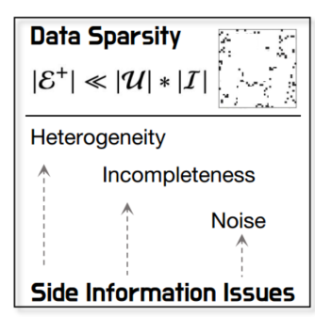
Introduction
explicit augment potential user-item interactive edges as well as enhances user/item node side information
i) Reinforcing user-item interaction edges
ii) Enhancing item attribute modeling
iii) Conducting user profiling

Slide 4
Approach

Slide 5
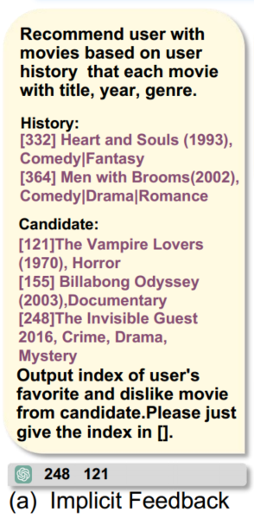
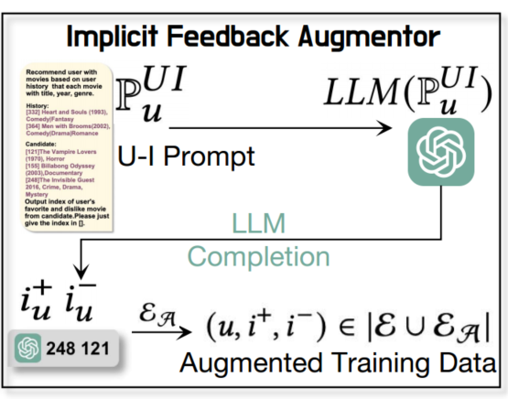
Approach

Slide 6
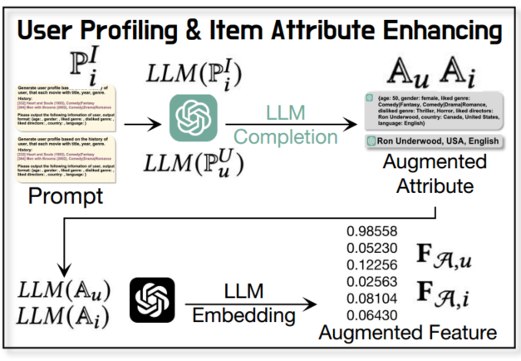
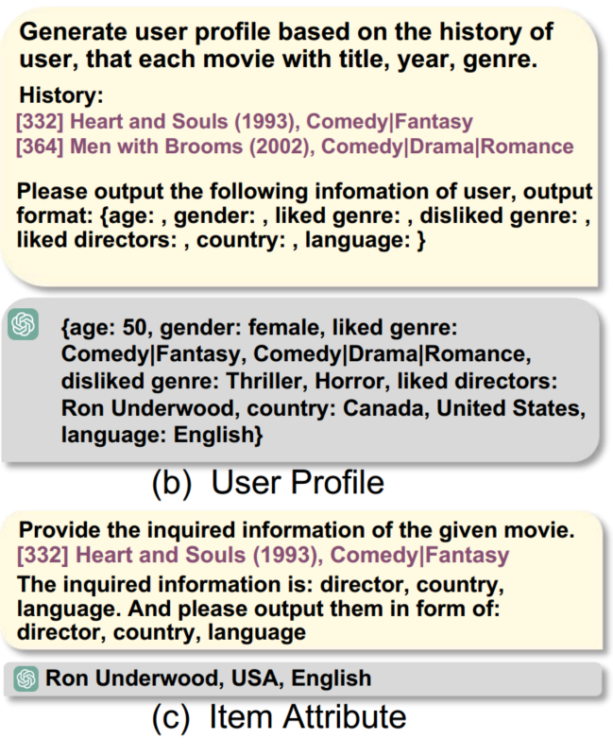
Approach

Slide 7
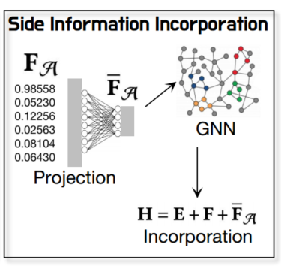
Approach

Slide 8
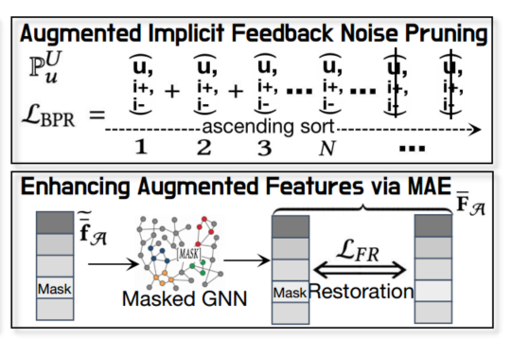
Approach

Slide 9
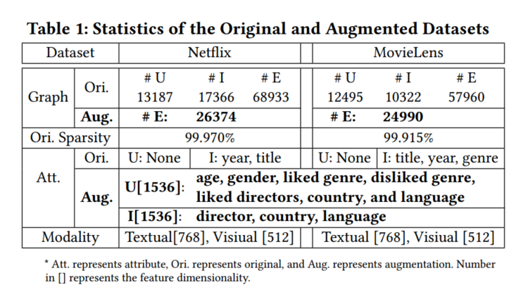
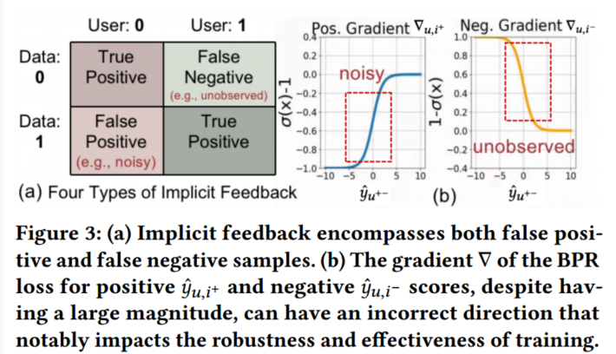
Experiment

Slide 10
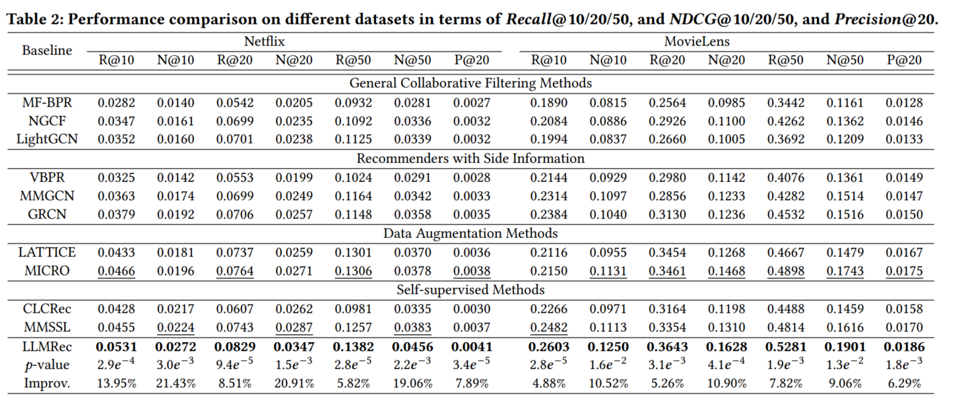
Experiment

Slide 11
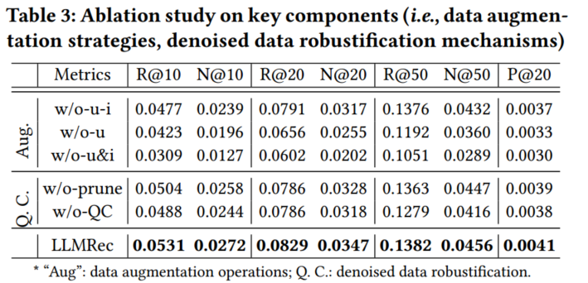
Experiment

Slide 12
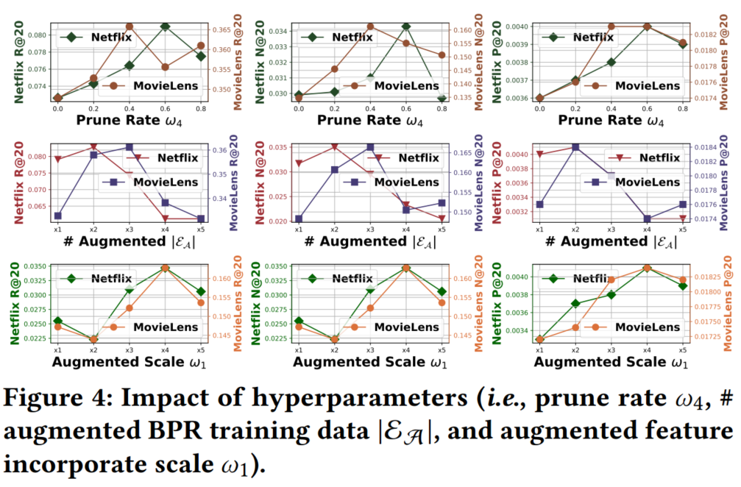
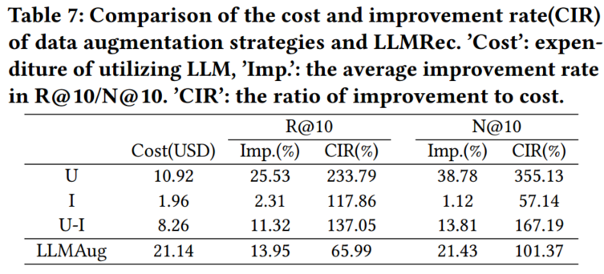
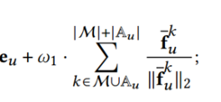
Experiment

Slide 13
Thank you!

